Slide 1


DATA
ANALYSIS

Slide 2


Today's agenda
Project recap
Problem
The Analytics team
Process
Insights
Summary

Slide 3

Social Buzz emphasizes content by keeping all users anonymous, only tracking user reactions on every piece of content.This is One of the Booming technology.
Accenture starts 3 month Poc focusing on these tasks:
An audit of their big data practice
Recommendations for a successful IPO
An analysis of their content categories that highlights the top 5 categories with the largest aggregate popularity
Project Recap

Slide 4

Problem
Every day over 100,000 pieces of content is posted and the data format is unstructured.
Anaysis to find Social Buzz’s top 5 most popular categories of data
Notes:
. Every day over 100,000 pieces of content

Slide 5



Andrew Fleming (Chief Technical Architect),
The Analytics team
Marcus Rompton (Senior Principle)
Padharthi Vyshnavi
(Data Analyst)

Slide 6
Process
1
Data Understanding
2
Data Cleaning
3
Data Modelling
4
Data Analysis
5
Uncover Insights

Slide 7

Insights
16
Unique categories
JANUARY
Most Posts
1897
Reactions to “Animal” Posts

Slide 8
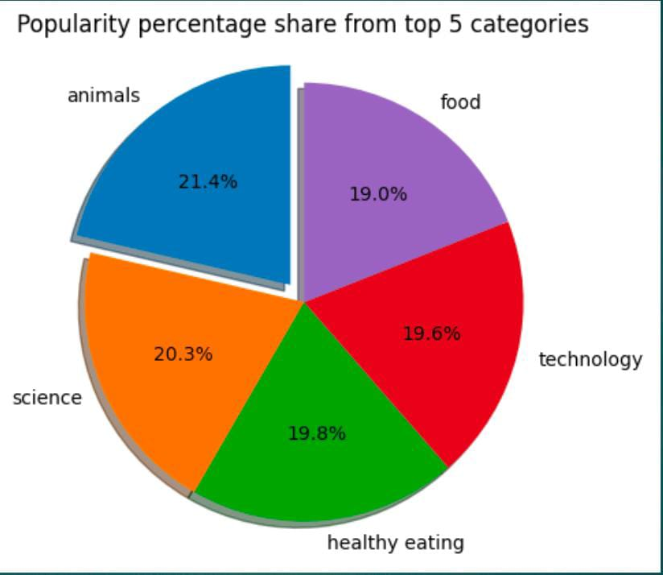

Slide 9
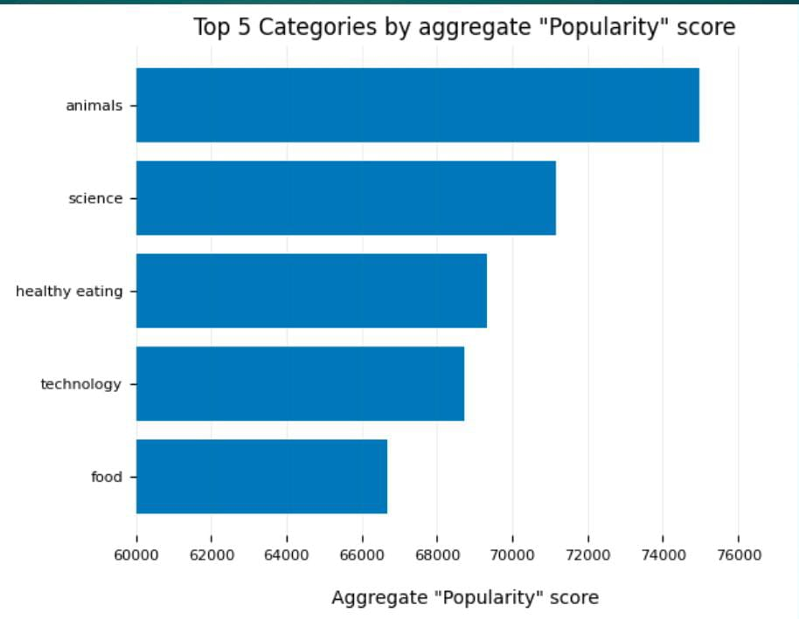

Slide 10

Analysis:
Animals and science are the top 2 category content shared in the Social Media Buzz. This States that people are more interested in these type of content
Summary
Insight:
Food is a common theme with in the top 5 categories of content. ”Healthy Eating” tops in the ranking.This helps to promote the healthy eating brands to boost user engagement by conducting a campaign
NEXT STEPS:
This analysis helps to understanding of people most liked content and steps to recreate their business that enhances customer satisfaction

Slide 11
Thank you!
ANY QUESTIONS?

